Slide 1
Omni shea
A social media site made for the people by the people

Slide 2
What is omni shea
Omni shea is a social website and forum where content is socially curated and promoted by site members through voting.
Registered users submit content to the site such as links, text posts, images, and videos, which are then voted up or down by other members. Posts are organized by subject into user-created boards called "communities" or "subreddits". Submissions with more upvotes appear towards the top of their subreddit.

Slide 3
Basic Features of OMNI SHEA
DATABASE BASED REGISTRATION
CAN CREATE POST ON CREATE POST PAGE
TEXT , IMAGES & VIDEO CAN BE UPLOADED
PROFILE PICTURE CAN BE ADDED
CAN COMMENT ON EACH POST
POST UPLOADED BY SAME ACCOUNT IS SHOWN IN MY PROFILE PAGE
YOUR PROFILE INFO LIKE USERNAME AND EMAIL ASWELL AS BIO IS SHOWN IN PROFILE PAGE.
PROFILE INFORMATION LIKE EMAIL , BIO AND PROFILE PIC CAN BE UPDATED

Slide 4
How we deliver business value?
Our primary motto is to understand the requirement of our client related to social bookmarking website
Later we outperform our ways to offer them with technological solution while keeping your target audience and market in mind . Let’s get in touch to find out how we can help you in bringing your social bookmarking website idea to life so that you can put forward your business in global market

Slide 5
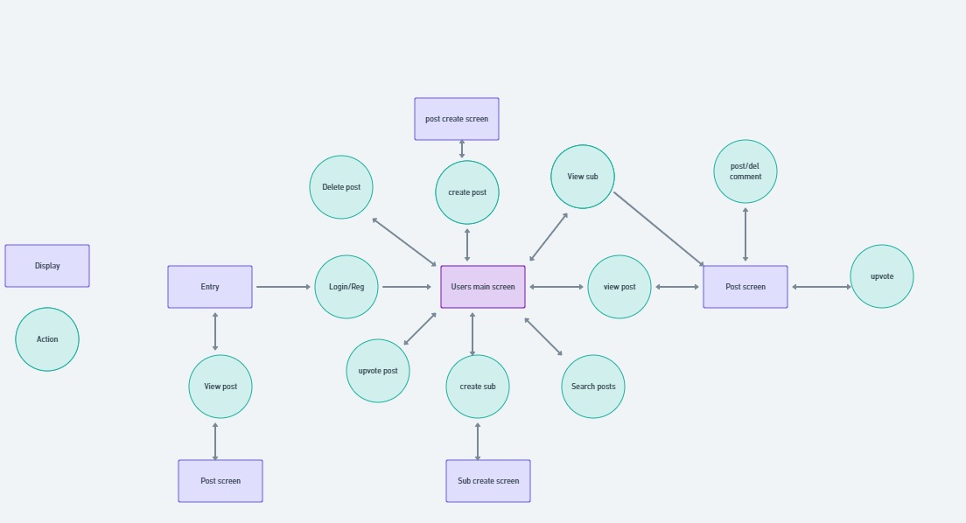
Dfd diagram

Slide 6
Tools and technology
HTML
CSS
PHP

Slide 7
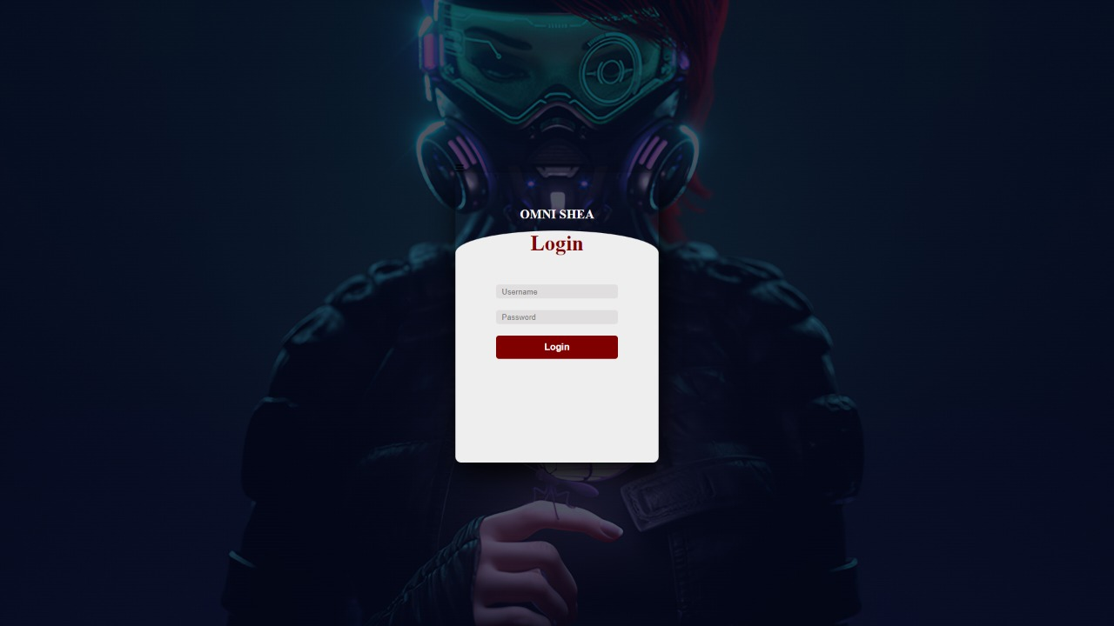
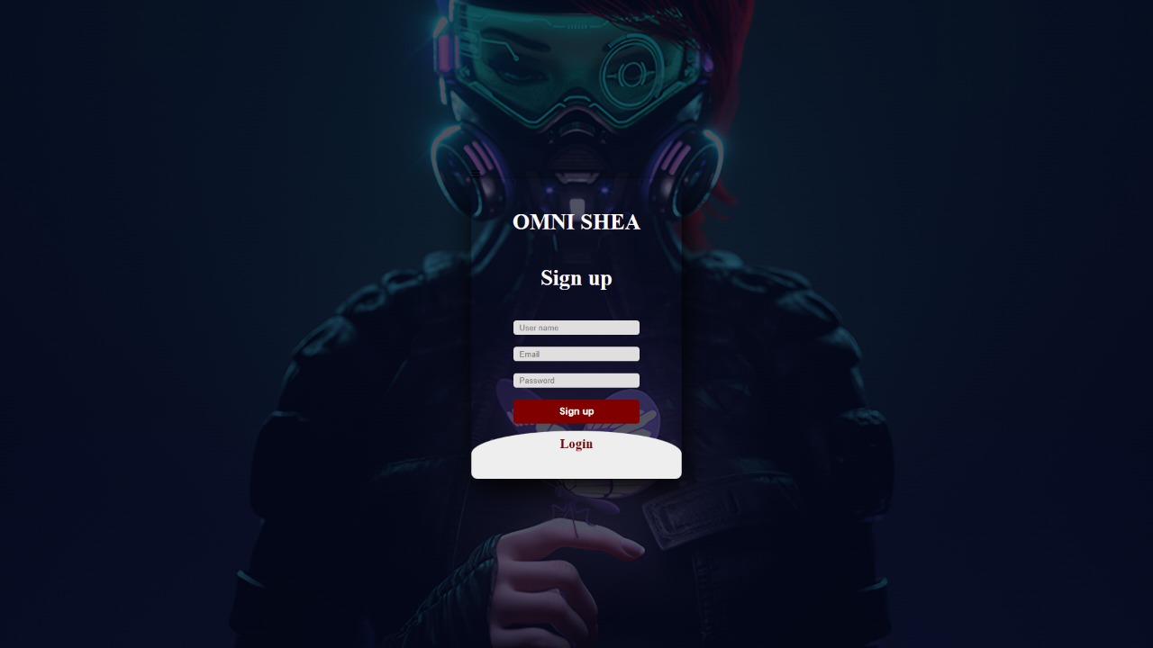
Sign up page

Slide 8
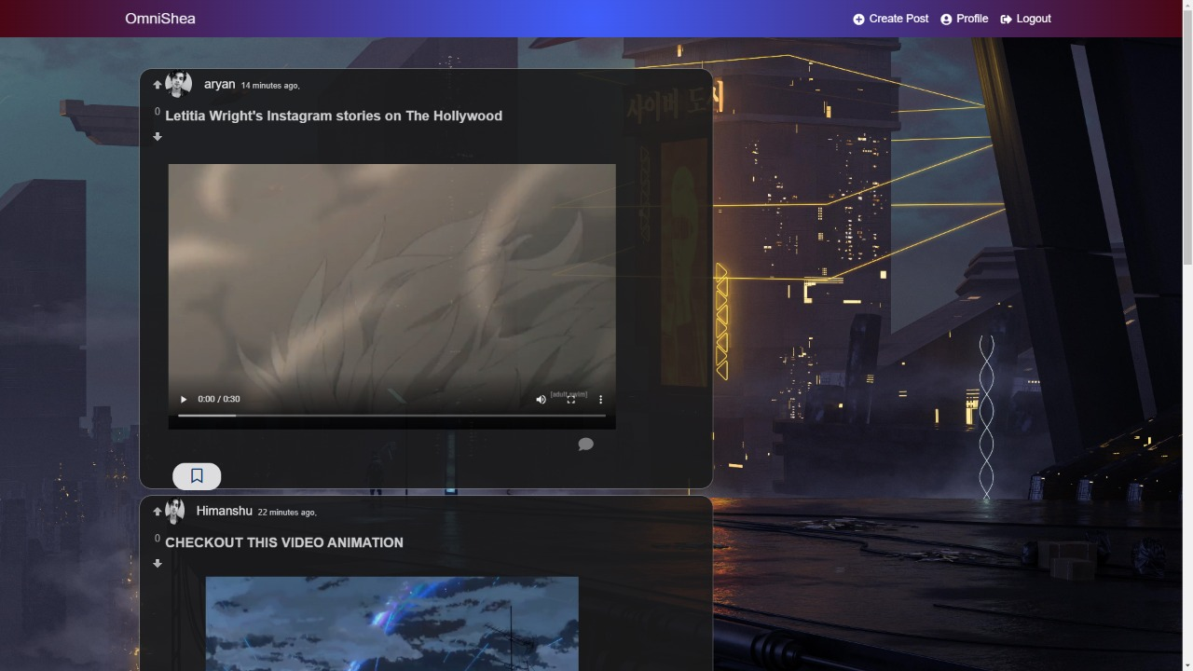
HOME PAGE

Slide 9
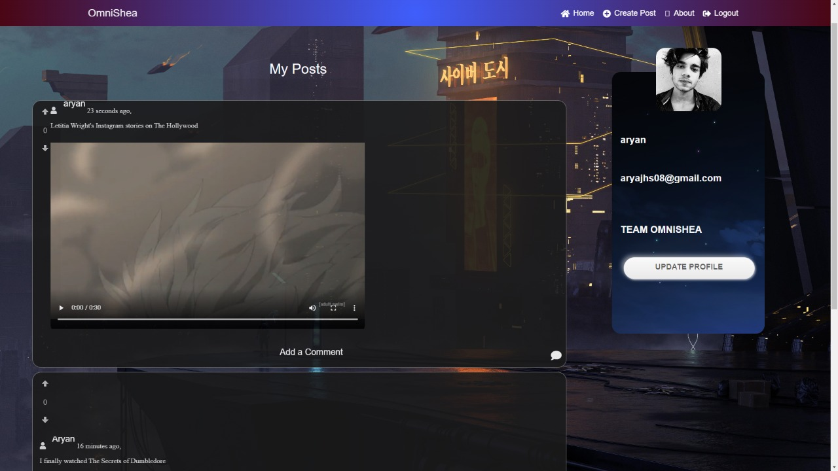
PROFILE PAGE

Slide 10
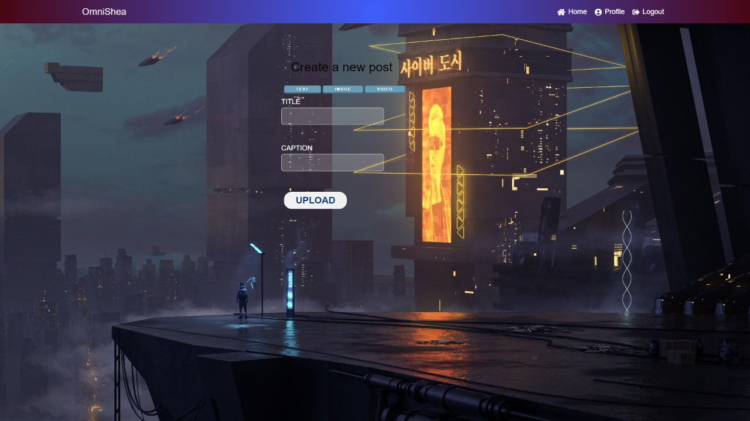
NEW POST (TEXT)

Slide 11
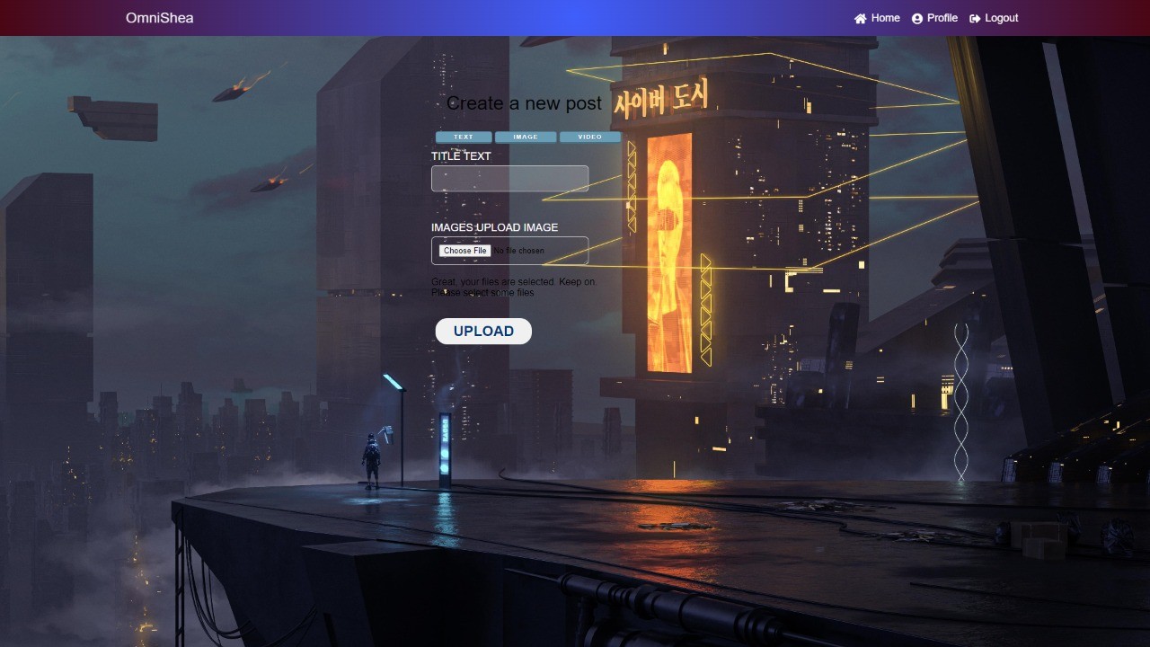
NEW POST (PHOTOS ,VIDEOS)

Slide 12
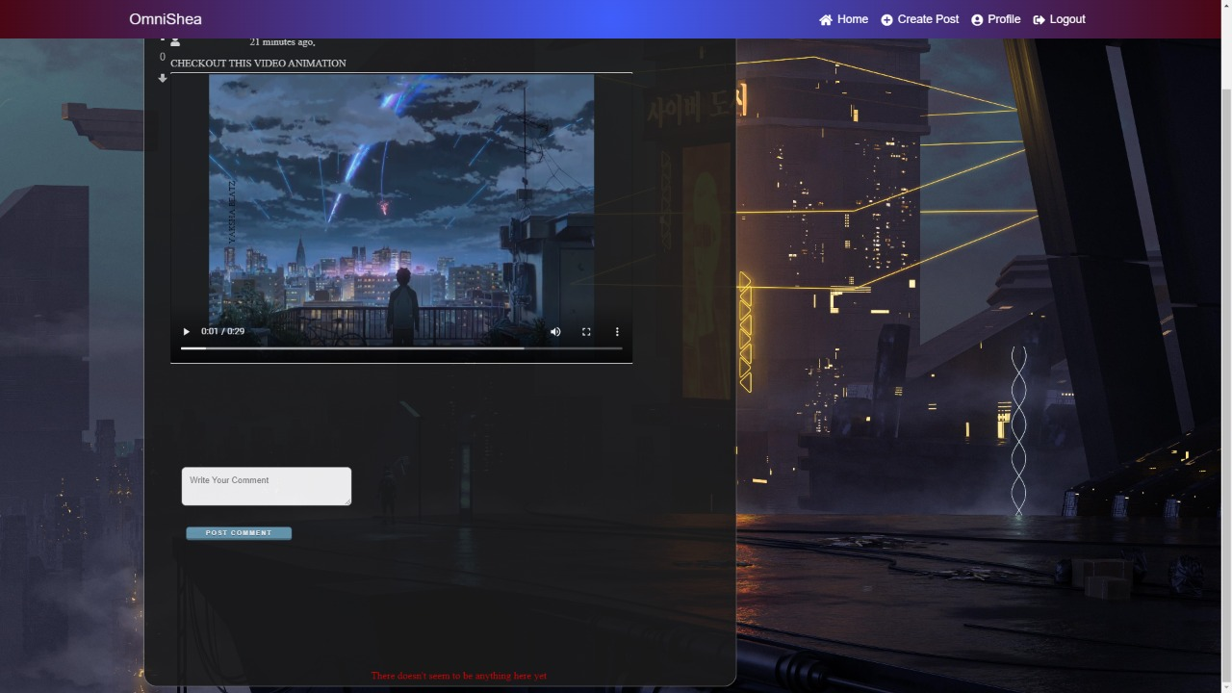
COMMENT SECTION

Slide 13
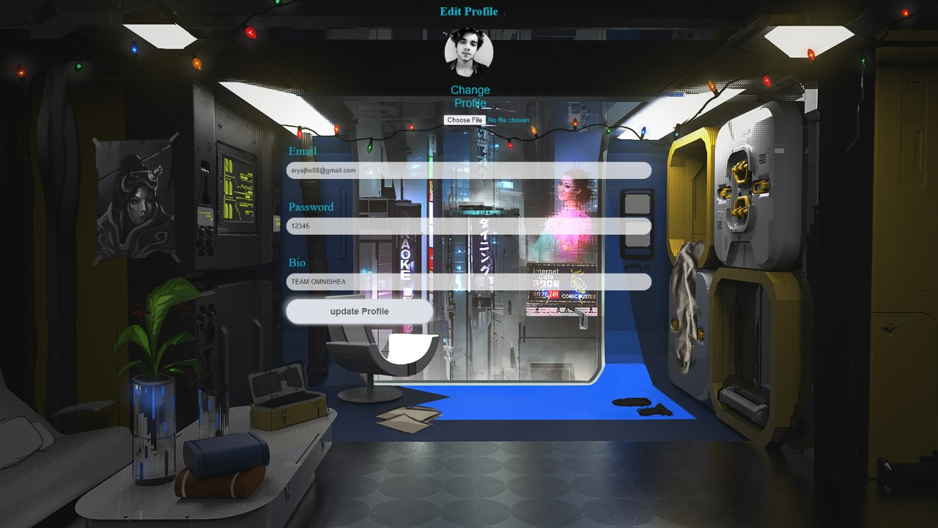
UPDATE PROFILE

Slide 14
OUR TEAM MEMBERS
Himanshu Tiwari(201500295)
ARYAN GUPTA (UI/UX)(201500149)
ASHUTOSH SAHU(201500168)
MRITYUNJAY DWIVEDI(201500416)
ADITYA VISWAKARMA(201500042)

